Slide 1

Universal Plug and Play Protocol
Presented by
Mr. Swapnil Suryakant Patil
Roll no: 305128 Class: B
Under Guidance of
Prof. S. S. Pawar

Slide 2
Introduction
Architecture developed by Microsoft
It was created to integrate computers connected to the network for sharing purpose
Now used to integrate all sorts of devices such as Smart televisions, refrigerators, IGD (Internet gateway devices), Smartphones, printers.
These devices can talk to each other all automatically as we will discuss shortly

Slide 3
Alternate Technologies
Internet Of Things : It is great achievement for industry level automation methods
Miracast (Chromecast) : Supports easy mirroring functionality with wireless communication support
RFID : It has two components receiver and transmitter with an active or passive tag
NAS (Network Attached Server) : A local server that stores all kind of files to share among different network devices
Cloud : Three types of service SAAS, PAAS, IAAS

Slide 4
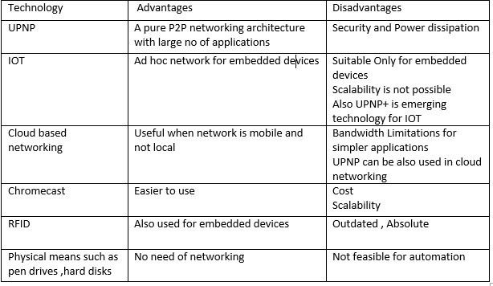
Alternate Technologies

Slide 5
“Interpolability” and “Configurability”
UPNP supports Interpolability
And it is “ZeroConf”
Architecture.

Slide 6
The Main Question
How does it work then?

Slide 7
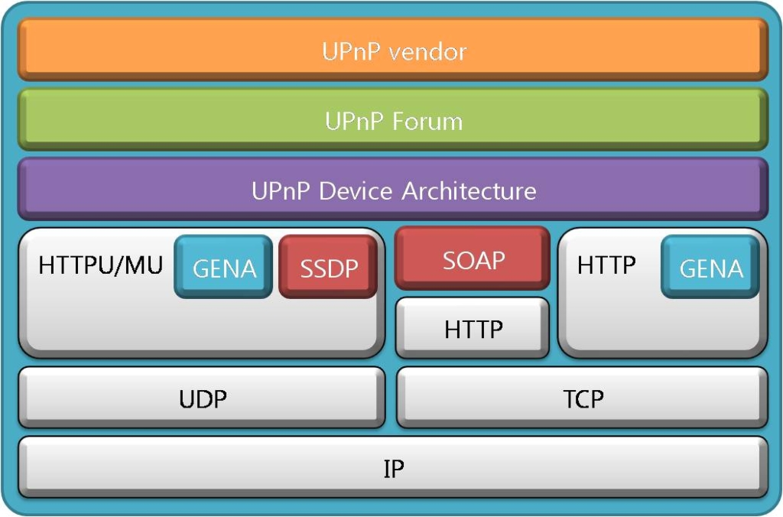
UPNP Architecture

Slide 8
UPNP Overview
UPNP is a simple protocol as it uses TCP/IP suite as its underlying layer as shown in previous dig.
Due to this fact, It makes UPNP a robust architecture
HTTP : This protocol is used to get the files that are essential for UPNP to work such as XML file that lists various services provided by the device node
SSDP : This protocol is heart of UPNP , Device Discovery is the main responsibility of this protocol
UDP for Multicasting : UPNP uses UDP for communication and discovery of all the devices connected to the network with the help of HTTPMU.

Slide 9
UPNP Overview
GENA (Generic Event Notification Architecture ) : A Simple subscribe and notify protocol which uses HTTP as a backend, This makes UPNP capable devices to subscribe to different events and get notifications when they occur
SOAP (Simple Object Access Protocol): provides ability to exchange parameters that are required by actions or commands executed on different device nodes
HTTPU/HTTPMU (HTTP with UDP multicasting): variants of http having support for udp multicasting

Slide 10
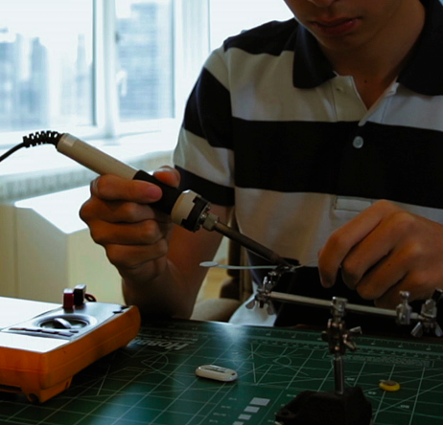
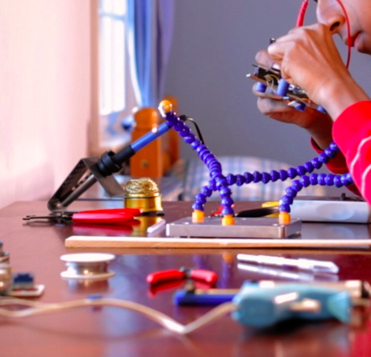
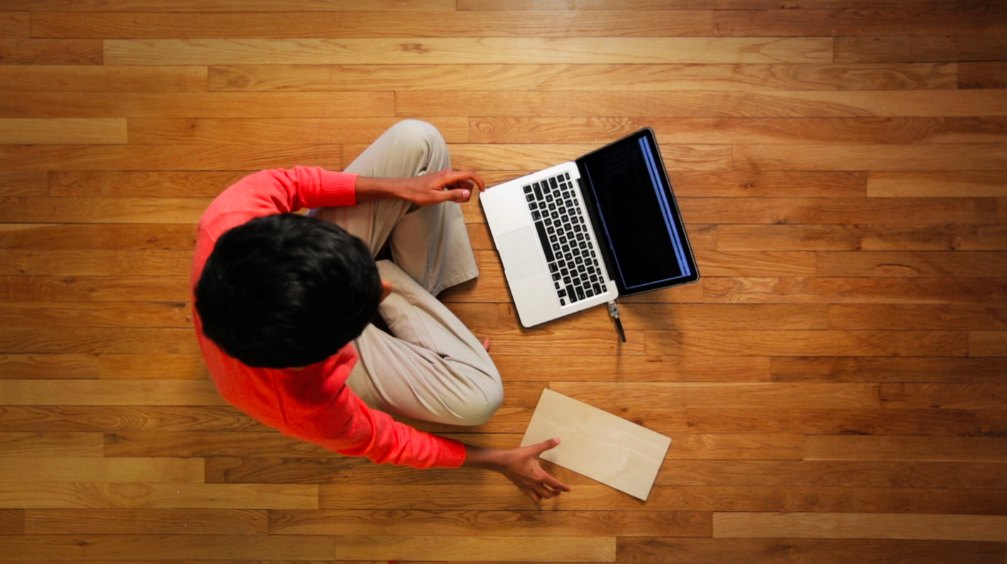
Step One: Addressing
Every device needs a ip address to communicate:
By means of DHCP (Dynamic Host Configuration Protocol)
If DHCP is not available it link local address range is chosen (169.254.0.0/16)

Slide 11
Step Two: Device Discovery
Discover available devices on the network that supports UPNP:
SSDP Does this job
It sends a udp multicast to 239.255.255.250 on port 1900
All the available devices responds this message about their profile to the device sending discovery msg

Slide 12
Step Three: Description
Every device maintains its profile in a XML file.
XML file contains device info such as services it provide, icons, event subscription urls and lot more.
HTTP transfers this XML file to control point (device which sends discovery msg)
Now the CP will know every device

Slide 13
Step Four: Control
The services available on various devices can be accessed in this step:
Services such as port forwarding, music and video streaming etc.
Requesting a service can be done by SOAP with sending correct parameters as RPC mechanism with XML.
Req is sent to the control url in <service> tag of device profile

Slide 14
Step Five: Eventing
The events such as playback aborted is notified to CP’s or subscribed devices for that event.
GENA is handy for eventing job.
Concept of state variables
These variables get changed upon occurrence of particular events and are notified to subscribed devices for that event.

Slide 15
Advantages
Great features of UPNP

Slide 16
Platform Independent (Interpolable)
Simplicity as TCP/IP suite used as a backend
No usage overhead i.e User is free from technicality and overall complexity known as “Autoconfig” or “Zeroconf”
Home Automation is possible due to services available such as Coffee machine makes coffee and when it is ready user is notified by Eventing capability of UPNP
Large developer community ex. OCF and UPNP forum
Evolving nature i.e. UPNP+ is developing for efficient sensor systems that will save power.

Slide 17
Disadvantages
Ok!! great features
But ….

Slide 18
Power inefficiency (Solution UPNP+)
Security : It is major drawback of UPNP and many developers and researchers are trying to make UPNP more secure

Slide 19
A Case Study (Application)
The Master Switch:
Mr. Alan arrive at home tired of all day’s work. Most of us will turn on the light, put some breakfast in the oven and so on. But with the help of UPNP Mr. Alan has a master switch that can automate these things. The Switch is simply a UPNP service defined by a state variable and when the variable changes, preset scripts will run on a pc device...

Slide 20
A Case Study (Application)
Now the Script will request the refrigerator to fill a cold glass of water, a smart tv will turn on and will play a favourite music, HVAC system will be turned on to maintain the home environment and so on all easily possible due to UPNP.

Slide 21
Conclusion
UPNP has some great features that will make it one day a industry standard for home automation, But security is major setback to this architecture that will hinder its usage.
UPNP has a wide scope of applications, research areas and a large supporting community for its future development and I intend to contribute for evolution of this amazing protocol.

Slide 22
References
[1] Shizhe Tan,Jing Zhang,Fajiang Sun,Department of Electronic Engineering,Ocean UniversityofChina“AnApproachtosupporttheInteroperabilityofIntelligentGrouping and Resource Sharing (IGRS) and Universal Plug and Play(UPnP) in Home Network Environment” IEEE 2015
[2] Guilherme Mussi Toschi,Leonardo Barreto Campos,Carlos Eduardo Cugnasca,University of Sao Paulo “An UPnP Architecture for Interoperability in Home Area Network” IEEE 2016
[3] Seong-Joong Kim,Appliance Recognition Unit for Home Energy Management System With UPnP Network,IEEE 2016

Slide 23

Thank You!!

